Slide 1
Crop Yield Production in India
Project Title: Use of Explainable AI using SHAP on Crop Yield Prediction in India Student Name: Udit Jain Roll No: 24CSM1R23 Guide Name: Mrs. Manjubala Bisi

Slide 2
Scope of the Project
Project Focus
Integrating SHAP into crop yield prediction models. Aiming for enhanced interpretability and predictive accuracy.
Expected Outcomes
Improved understanding of factors affecting crop yields. Better decision-making tools for farmers and policymakers. This project seeks to bridge the gap between AI and agriculture!

Slide 3
Key Studies and Findings
Significant Research
Studies demonstrating the effectiveness of AI in agriculture. Highlighting the need for explainability to foster trust among users.
Focus on Explainability
Research emphasizing the importance of understanding AI decisions in agriculture. SHAP's role in improving predictive accuracy and user trust. Key studies pave the way for our proposed solution!

Slide 4
Model Development Process
Stages of Development
Selection of appropriate algorithms for crop yield prediction. Training models using historical data and SHAP for interpretability.
Algorithm Selection
Exploring various machine learning techniques such as Decision Tree, Random Forest and XgBoost, CNN, LSTM. Ensuring models are tailored for agricultural contexts. The development process is crucial for achieving reliable results!

Slide 5

Introduction to Explainable AI
Explainable AI (XAI) refers to methods and techniques that make the output of AI systems understandable to humans.
Importance: Enhances trust and transparency in AI decisions.
Relevance in Agriculture: Critical for decision-making in crop yield prediction, ensuring farmers and stakeholders understand model outputs.
Understanding AI is essential for effective agricultural analytics!

Slide 6
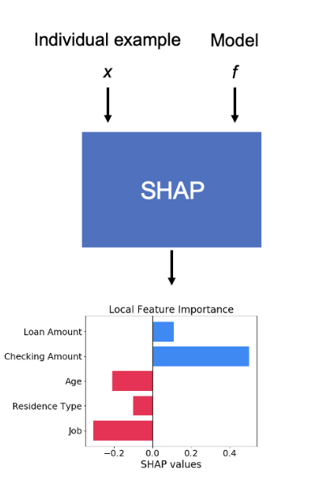
SHAP Methodology Overview
SHAP stands for SHapley Additive exPlanations.
Core Principle: Each feature's impact is calculated by comparing what the model predicts with and without that feature.
Working:
Start with a model prediction for a specific data instance.
Identify the baseline output (average prediction with no features).
Add each feature one at a time to observe its impact.
Compute SHAP values as the average marginal contribution of each feature.
Ensure additivity: all SHAP values sum up to the final prediction.
Visualize results using SHAP plots to explain feature influence.

Slide 7
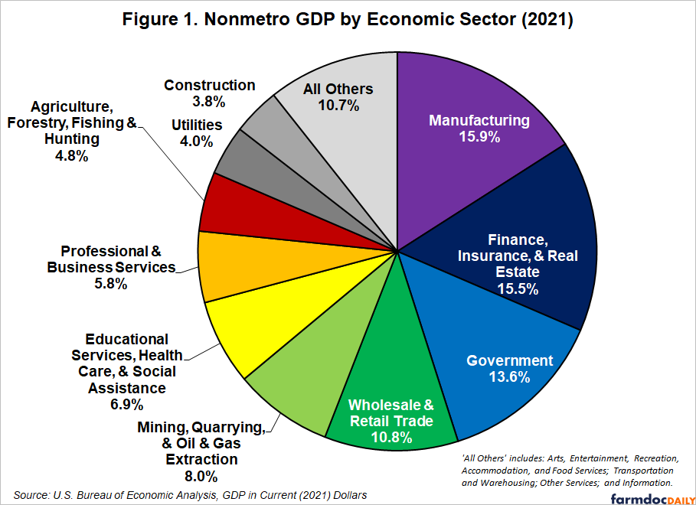
Importance of Crop Yield Prediction
Economic Impact:
Accurate predictions can enhance farmers' income and national economic stability.
Food Security: Predicting yields aids in planning for food supply, addressing hunger issues.
Resource Management: Helps optimize the use of water, fertilizers, and land, promoting sustainable practices.
Crop yield prediction is vital for India's agricultural landscape!

Slide 8
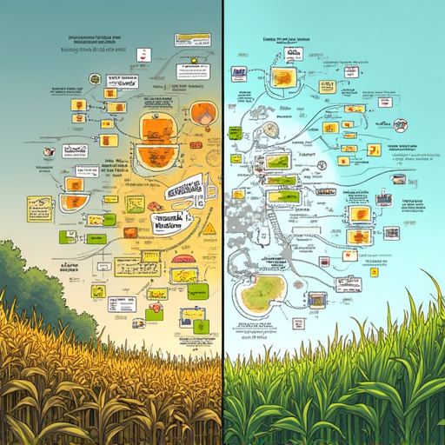
Problem Statement
Key Challenges:
Traditional AI methods often lack transparency in predictions.
Difficulty in understanding how various factors influence yield predictions.
Issues in Crop Yield Prediction:
Variability in environmental conditions.
Limited access to reliable data sources. Understanding these challenges is crucial for effective solutions!

Slide 9


Significance of the Problem
Consequences of Inaccurate Predictions
Inaccurate predictions can lead to economic losses for farmers due to poor planning and an increased risk of food scarcity and insecurity.
Broader Implications
These inaccuracies affect agricultural policy and resource allocation, highlighting the need for reliable predictive models. The far-reaching effects on society cannot be overlooked!

Slide 10
Literature Survey Overview
Existing Research
Role of Explainable AI
Importance of Understanding
Various methods for crop yield prediction, including statistical and machine learning approaches, have been explored. However, there is a limited focus on explainability within these models.
There is a growing interest in making AI models interpretable. SHAP (SHapley Additive exPlanations) is emerging as a promising tool for enhancing model transparency.
Understanding the current landscape of research is essential for our project, as it informs our approach and helps identify gaps in the existing literature.

Slide 11

Gaps in Current Research
Identifying Gaps:
Lack of interpreted models in crop yield prediction.
Need for more research integrating explainability into agricultural AI.
Importance of Addressing Gaps:
Enhancing the reliability of predictions.
Supporting farmers with actionable insights. Filling these gaps is crucial for advancing agricultural analytics!

Slide 12
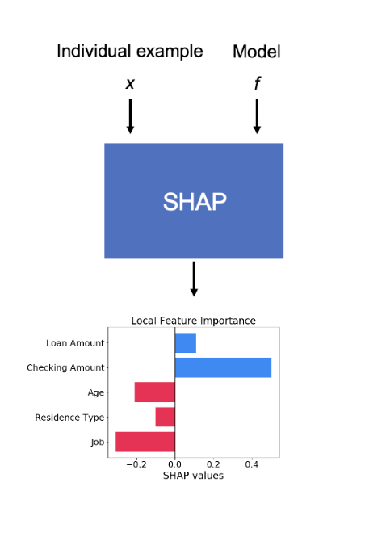
Proposed Solution Overview
Integrating SHAP:
Utilizing SHAP to enhance crop yield prediction models.
Aiming for improved interpretability and accuracy.
Expected Benefits:
Better insights into the factors influencing crop yields.
Increased trust in AI-driven predictions among stakeholders. Our solution aims to revolutionize crop yield prediction!

Slide 13
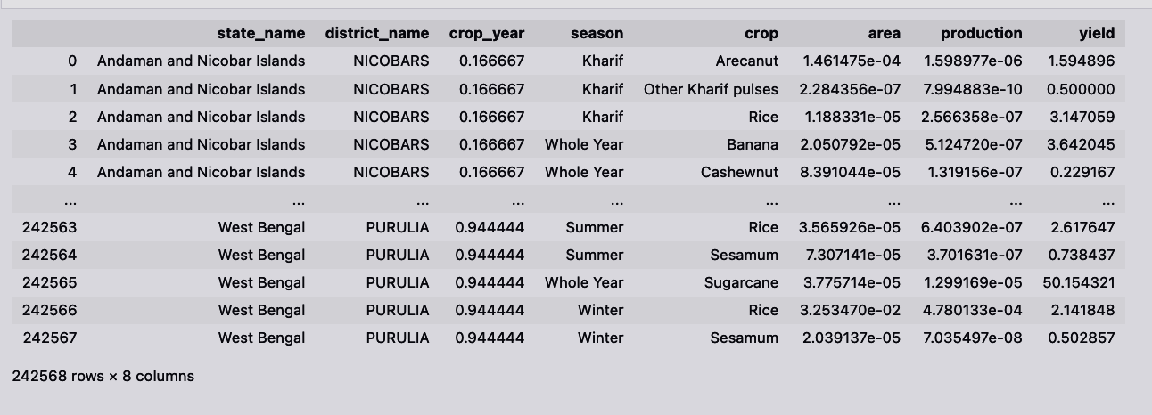
Data Collection and Methodology
Data Sources
Methodology
Utilization of agricultural datasets from government and research institutions, incorporating environmental, economic, and historical data.
The dataset includes data on multiple states and districts across India, capturing seasonal crop yield information with parameters such as:
State Name and District Name
Crop Year and Season
Crop Type, Area, Production, and Yield
Employing machine learning and deep learning algorithms alongside SHAP for analysis, ensuring robust validation of models through cross-validation techniques. Data integrity is key to successful predictions!
Dataset

Slide 14
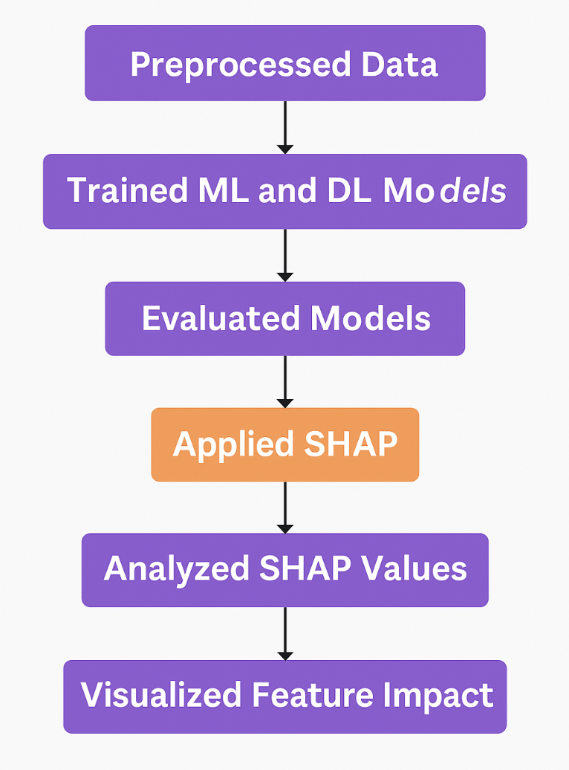
Implementation of SHAP
Workflow Steps:
Preprocessed the crop yield dataset (cleaning, encoding, and normalization).
Trained ML and DL models including Random Forest, Decision Tree, and XGBoost, RNN.
Evaluated models using metrics: Accuracy, MAE, RMSE, and SD.
Applied SHAP to the best-performing model (Random Forest) for explanation.
Analyzed SHAP values to identify key features.
Visualized feature impact using summary, waterfall, and decision plots for interpretation.

Slide 15
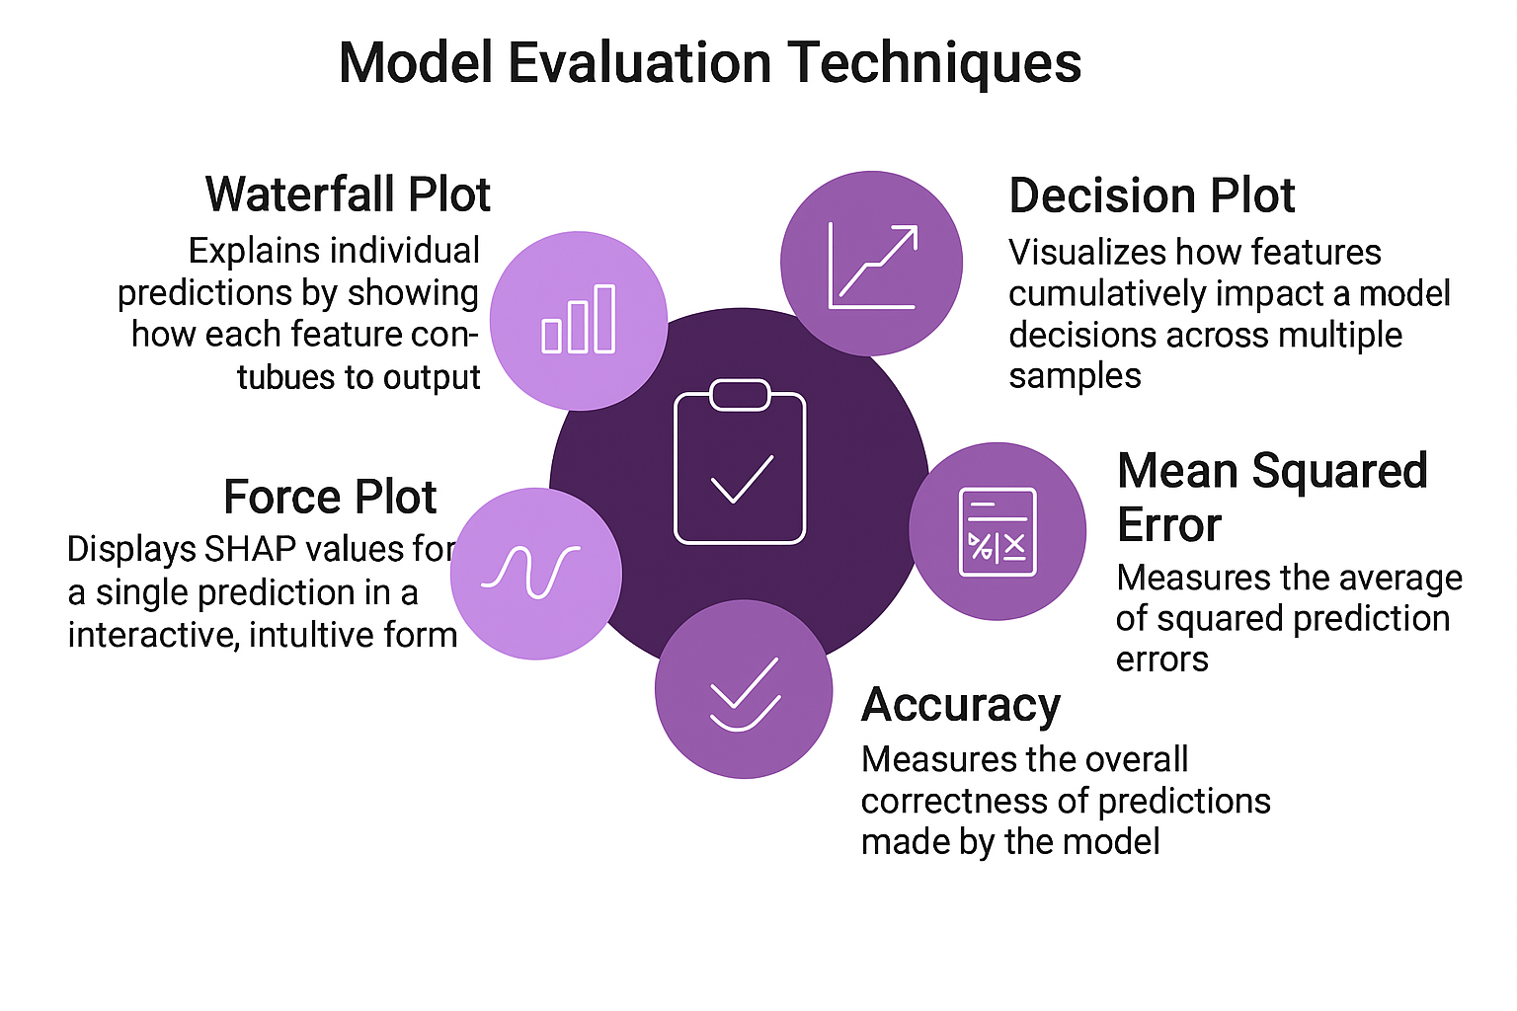
Performance Metrics
Evaluation Criteria
Accuracy, MAE, and RMSE were used to evaluate model performance.
SHAP values were used to interpret model predictions and analyze feature importance.
SHAP Summary Plot highlighted key features: Crop_Coconut, Area, Season_Kharif
SHAP Waterfall Plot visualized the contribution of individual features to a single prediction
SHAP Decision Plot illustrated feature influence across multiple predictions
This approach ensured that models were not only accurate but also explainable, supporting informed decision-making in crop yield prediction.

Slide 16
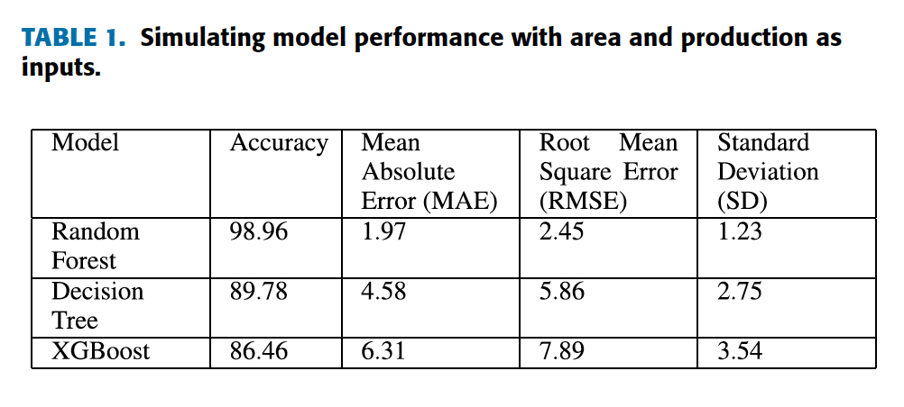
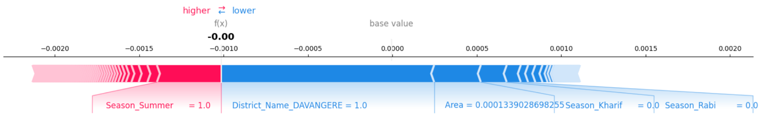
Results Overview
Force Plot
Key Results Achieved:
Achieved 98.96% accuracy using Random Forest with MAE: 1.97, RMSE: 2.45.
SHAP identified key features: Crop_Coconut, Area, Season_Kharif, Crop_Rice.
Waterfall plot showed District_TIRUNELVELI and Crop_Urad as strong positive contributors.
Decision plot illustrated consistent positive impact of Area, with variable effect from Crop_Rice.
SHAP improved model interpretability and trust, enabling informed agricultural decisions.

Slide 17
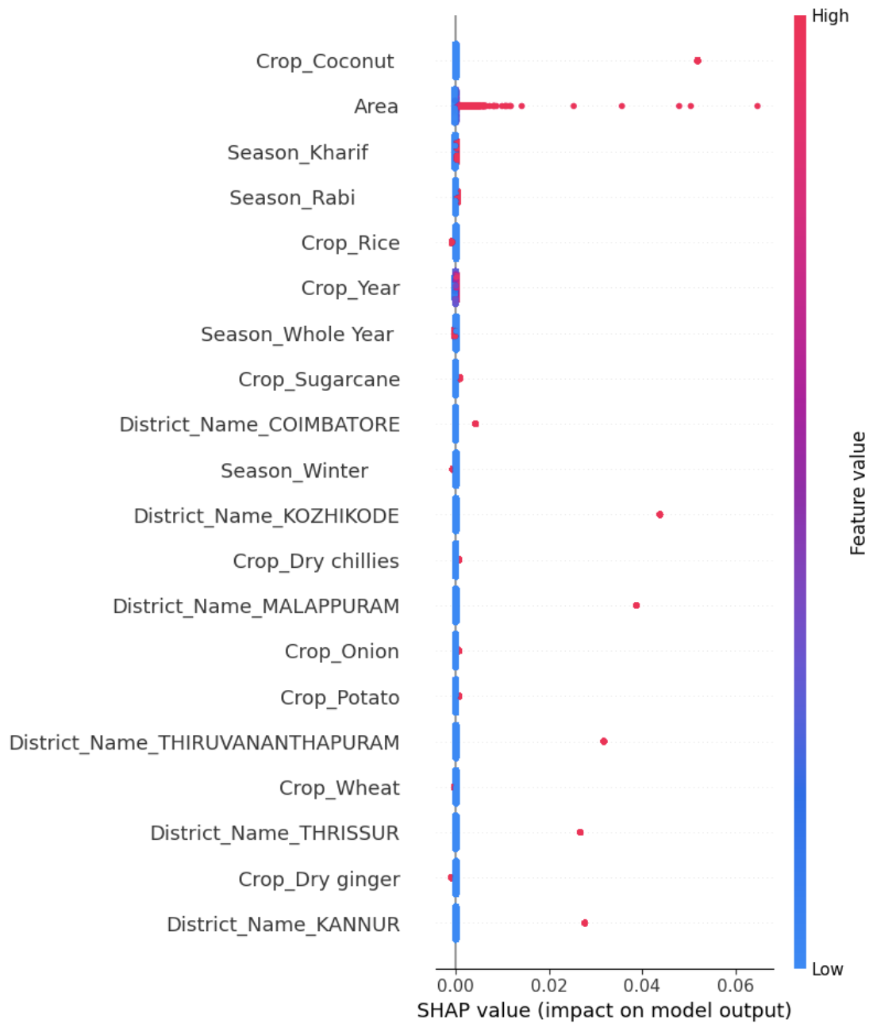
Interpretation of Results
Summary Plot
In-Depth Analysis
SHAP plots provided clear interpretability by showing:
Area had the strongest positive influence on yield.
Waterfall and force plots highlighted District_TIRUNELVELI, Crop_Urad, and Season_Kharif as key contributors to specific predictions.
Decision plot revealed consistent positive impact of Area and variable influence from Crop_Rice.
Implications of Findings
Enhanced transparency and interpretability improves trust in model outcomes.
Supports data-driven decisions for optimizing crop planning and resource allocation.
Insights can guide region-specific policies by identifying high-impact crops and conditions.

Slide 18
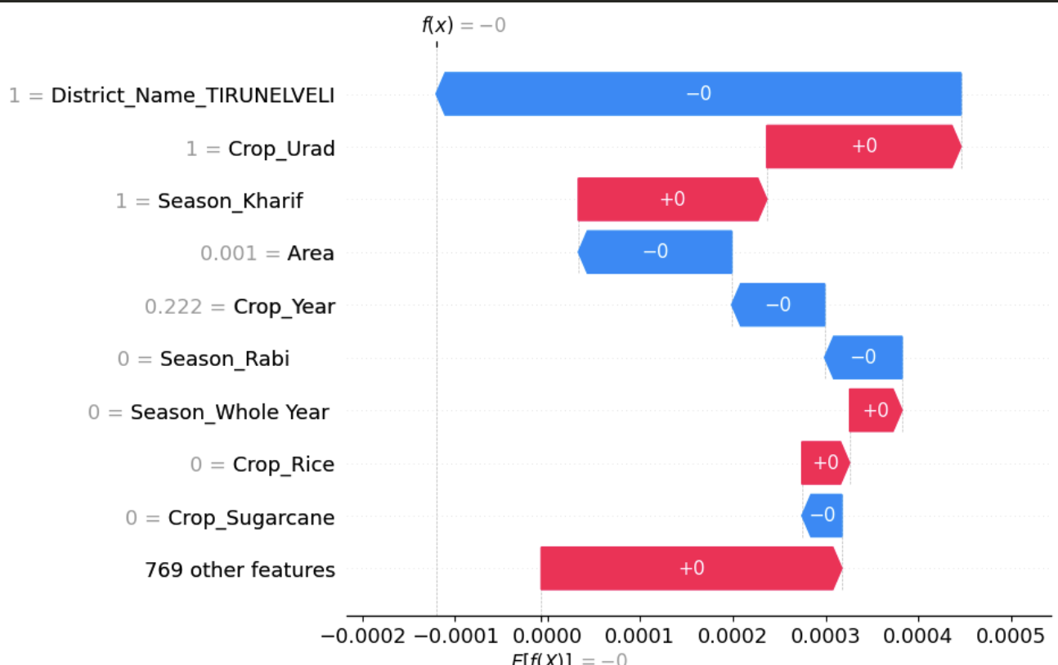
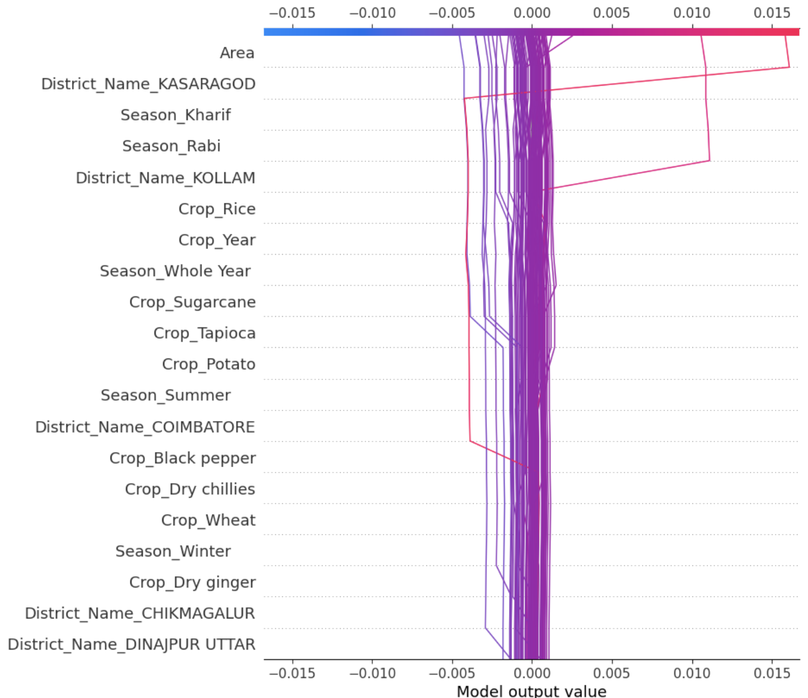
Visualizing SHAP Values
SHAP Value Representations
Waterfall plot breaks down individual predictions feature by feature.
District_TIRUNELVELI, Crop_Urad, and Season_Kharif had strong positive contributions.
Features like Season_Rabi, Crop_Rice, and Sugarcane showed minimal or negative influence.
Decision plot shows cumulative effect of features over multiple samples.
Area and District_KASARAGOD consistently increased predicted yields.
Crop_Rice exhibited a variable effect, depending on the combination of other features.
Waterfall Plot
Decision Plot

Slide 19
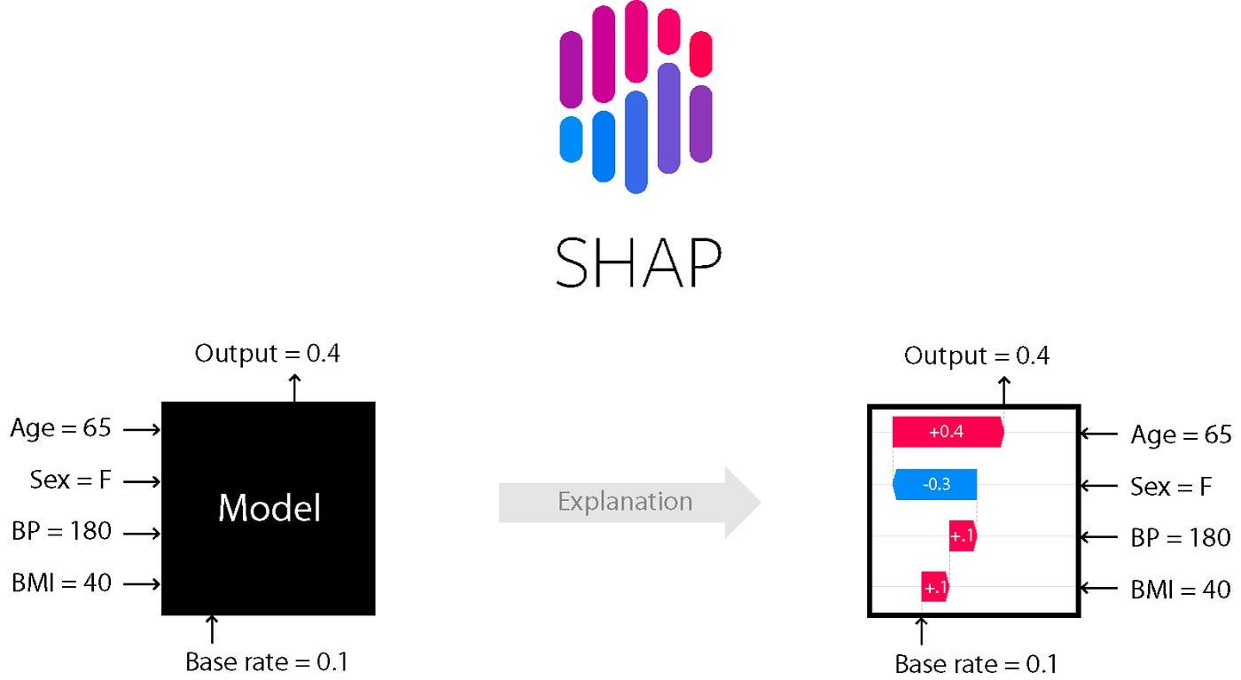
Comparison with Traditional Models
Performance Comparison
Random Forest + SHAP achieved 98.96% accuracy
Outperformed:
Decision Tree: 89.78%
XGBoost: 86.46%
Lowest MAE (1.97) and RMSE (2.45) among all models
Evaluating SHAP-enhanced models against traditional predictive models highlights improvements in accuracy and interpretability.
Key Takeaways
SHAP-enhanced models deliver higher accuracy and better error metrics
Provide clear interpretability through feature contribution visualization
Enable greater user trust and informed decision-making in agriculture

Slide 20

Conclusion and Insights
Project Summary
Demonstrated how integrating Explainable AI with SHAP enhances both prediction quality and understanding.
Enabled stakeholders to not just see predictions, but also understand the why behind them.
Combined high model accuracy with interpretability, bridging the gap between AI performance and usability in agriculture.
Future Implications
Opens new directions for decision-support systems tailored to farmers and policymakers.
Lays the groundwork for scalable AI frameworks that can adapt across crops and regions.
Reinforces the importance of trustworthy AI in critical domains like food security and sustainability.

Slide 21
References
Comprehensive list of all sources and literature referenced throughout the research.
Tamayo-Vera, D., Mesbah, M., Zhang, Y., et al. (2025). Advanced machine learning for regional potato yield prediction: Analysis of essential drivers. npj Sustainable Agriculture. https://doi.org/10.1038/s44264-025-00052-6
Mahesh, P., & Soundrapandiyan, R. (2024). Yield prediction for crops by gradient-based algorithms. PLOS ONE. https://doi.org/10.1371/journal.pone.0291928
Dubey, Y., Sakhare, A., Tasare, A., Kakad, S., & Umate, R. (2025). Explainable model for agricultural crop yield prediction in Indian conditions with SHAP analysis. IJEC.
Next-gen agriculture: Integrating AI and XAI for precision crop yield prediction. Frontiers in Plant Science. https://doi.org/10.3389/fpls.2024.1451607
Explainable ML models for corn yield prediction using UAV multispectral data. Computers and Electronics in Agriculture. https://doi.org/10.1016/j.compag.2025.107713

